Slide 1


Department of Computer Science
Project Presentation
E-Portal for Case Management Hearing and facilitating of various types of cases
Project Guide : Prof. Anmol Jain , Assistant Professor
(Dept. of Computer Science)
Team Members: Aaditiya Tyagi(2200290120001)
Akash Tiwari(2200290120016)
Akshat Jain (2200290120019)
Ankit Chaudhary(2200290120032)

Slide 2
Problem Statement
The project titled "Development of e-Portal for Facilitating Case Management and Hearings" aims to provide an advanced, web-based.
platform designed to support the efficient management and.
adjudication of legal cases. This comprehensive e-Portal will streamline the judicial process by enabling key stakeholders—including judges, lawyers, plaintiffs, and defendants—to conduct case-related activities such as filing, scheduling, and hearing proceedings, all within a secure digital environment.
.

Slide 3
Project Abstract
Overview
Key Objectives
Approach
A streamlined legal case management system to enhance efficiency and productivity.
Optimize case handling with scheduling, document management, security, and communication improvements.
Implement role-based access and mobile-friendly interfaces for better management.

Slide 4
Objectives of Project
Streamline case management
Scheduling of hearing of cases
Enhance document Management
Improve communication
Ensure compliance
Role based access
Increased Efficiency

Slide 5


Key features
Case creation and assignment
Hearing/meeting scheduling
Document management
Pre-trial settlement
Real time notifications
Case reporting and closure
.

Slide 6
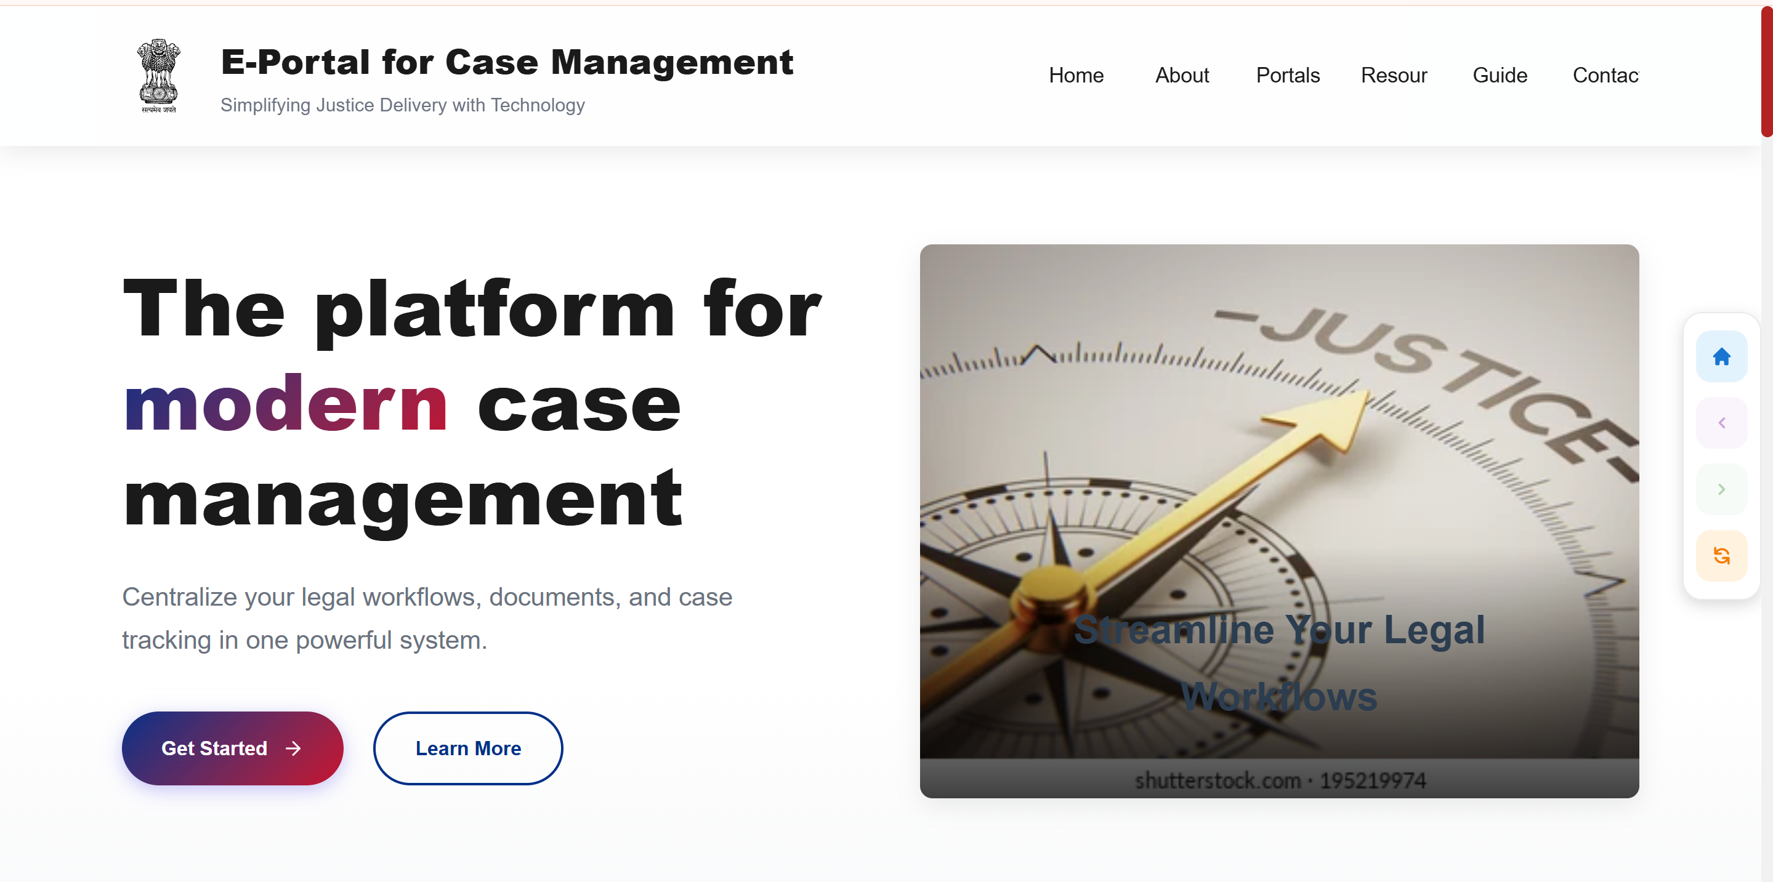
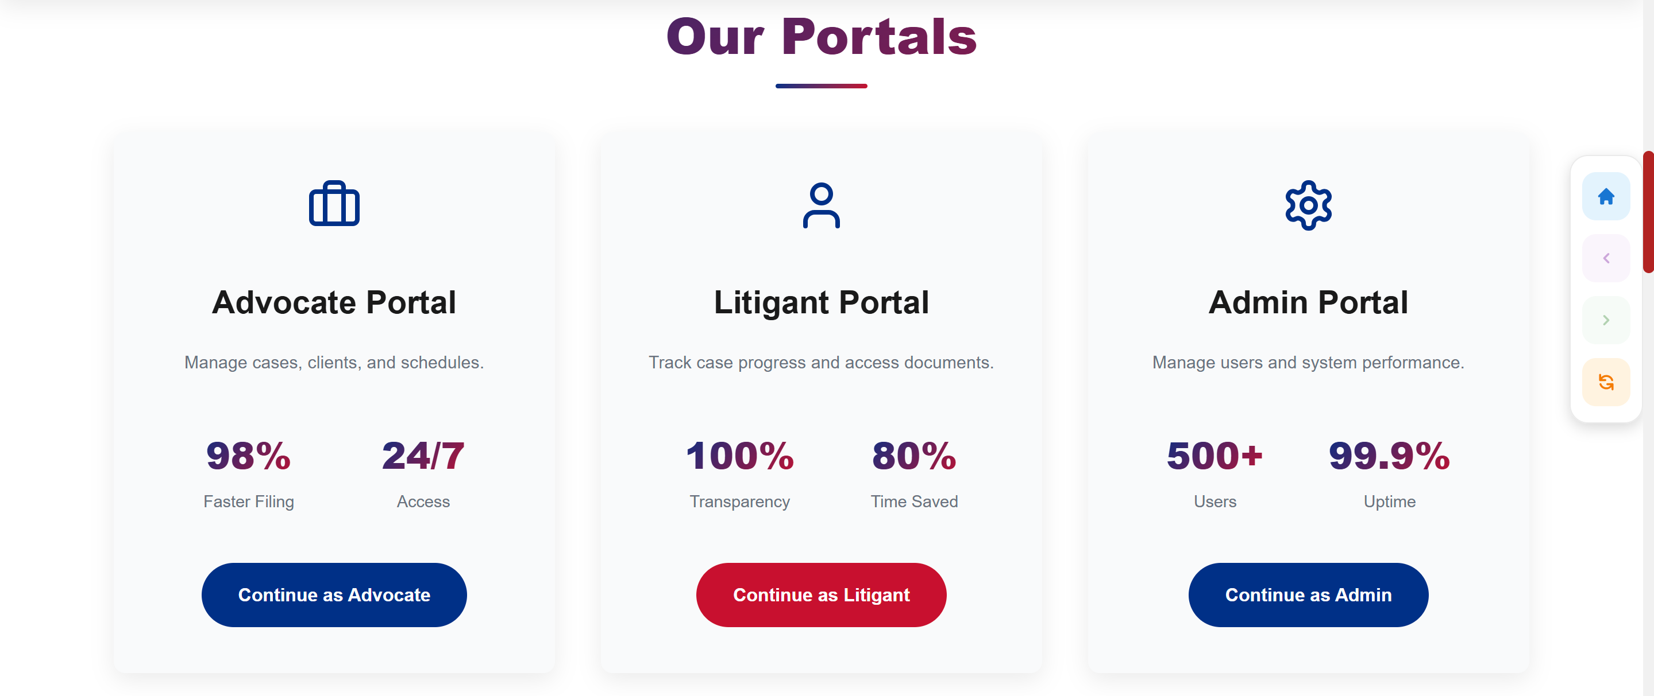
Project Implementation

Slide 7
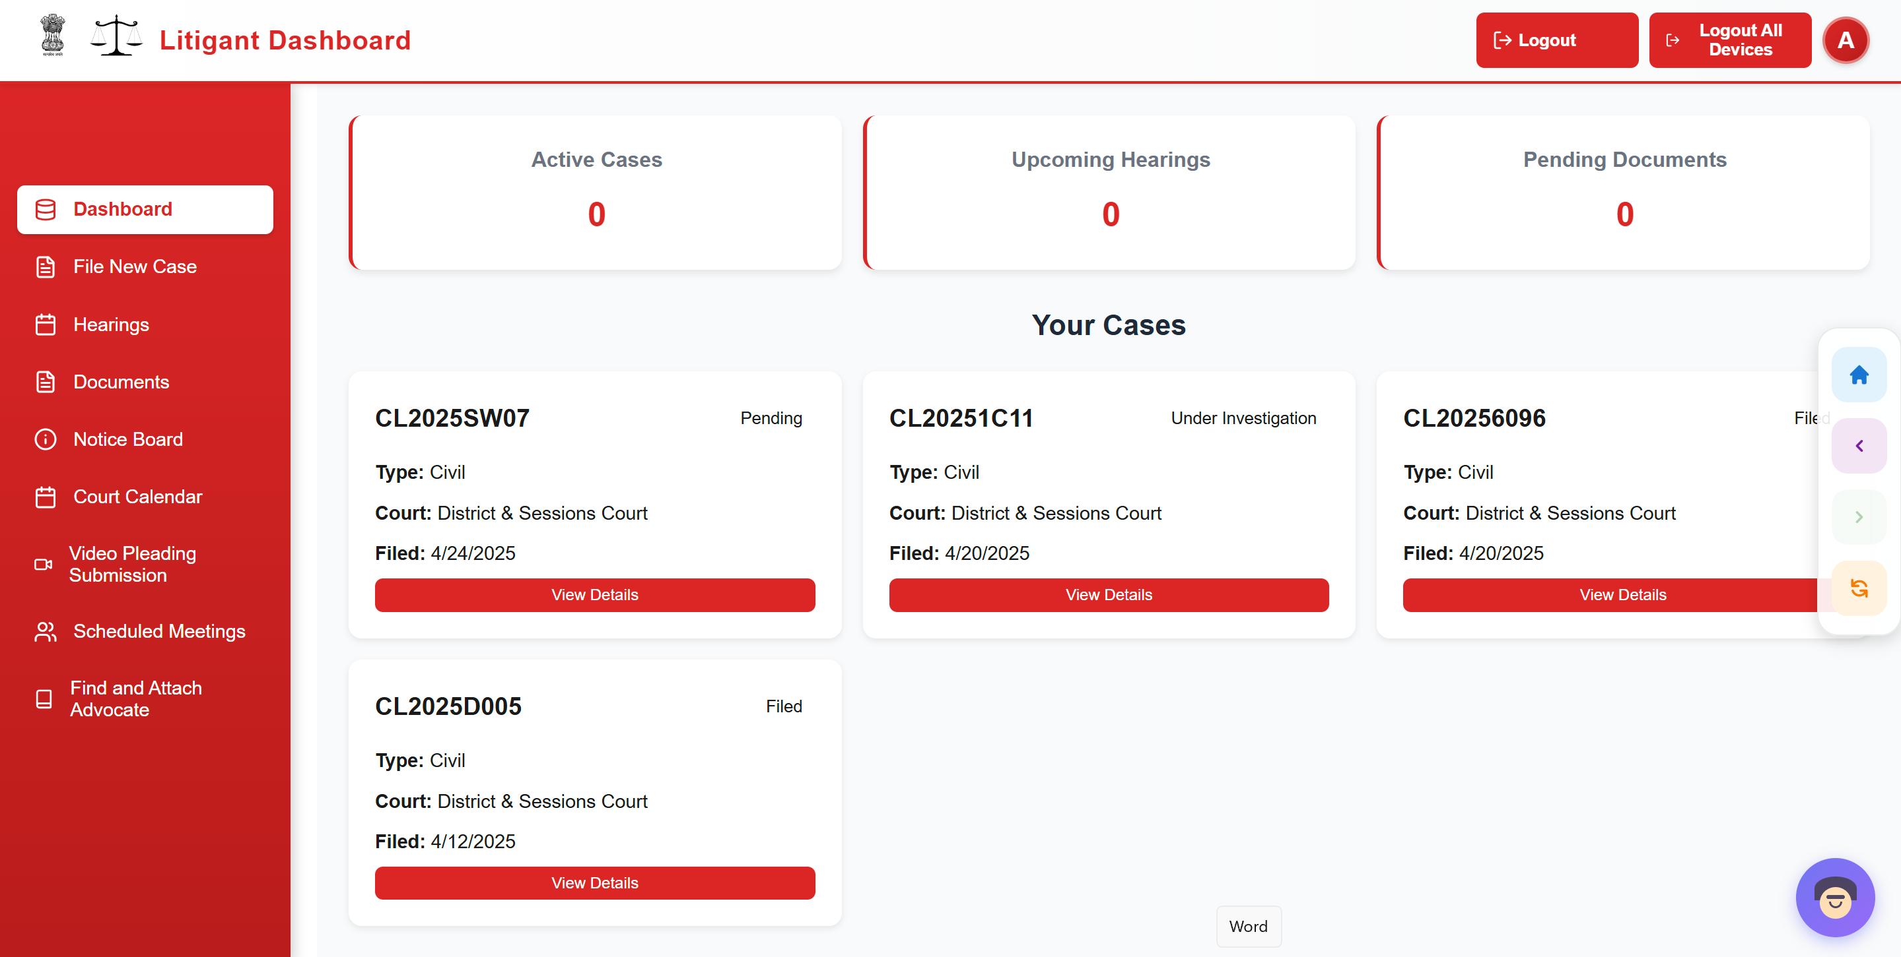
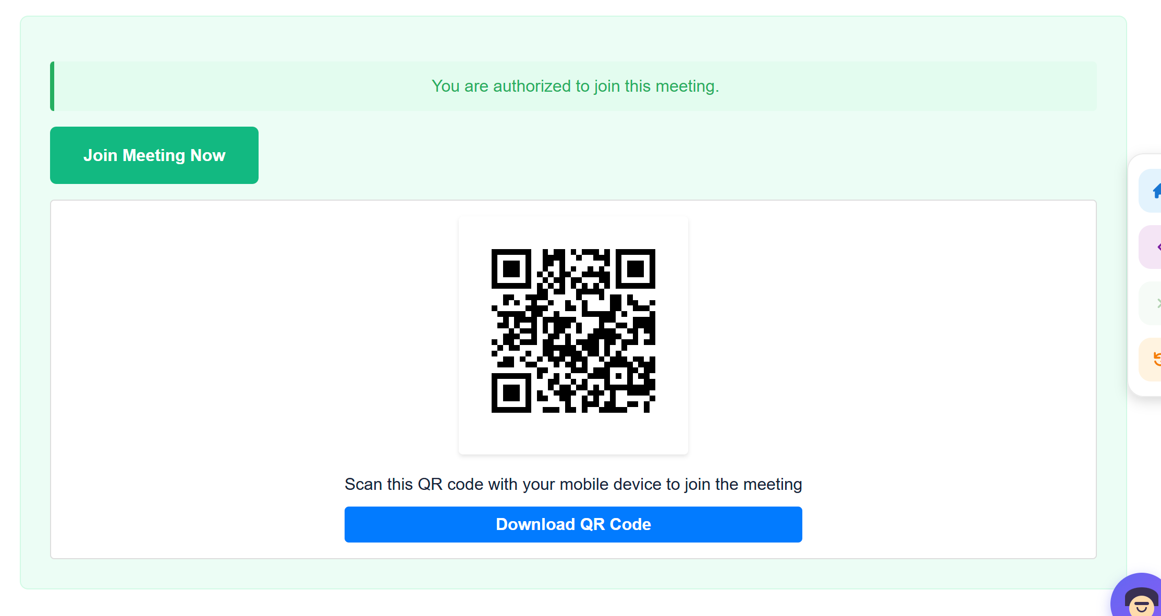

Slide 8
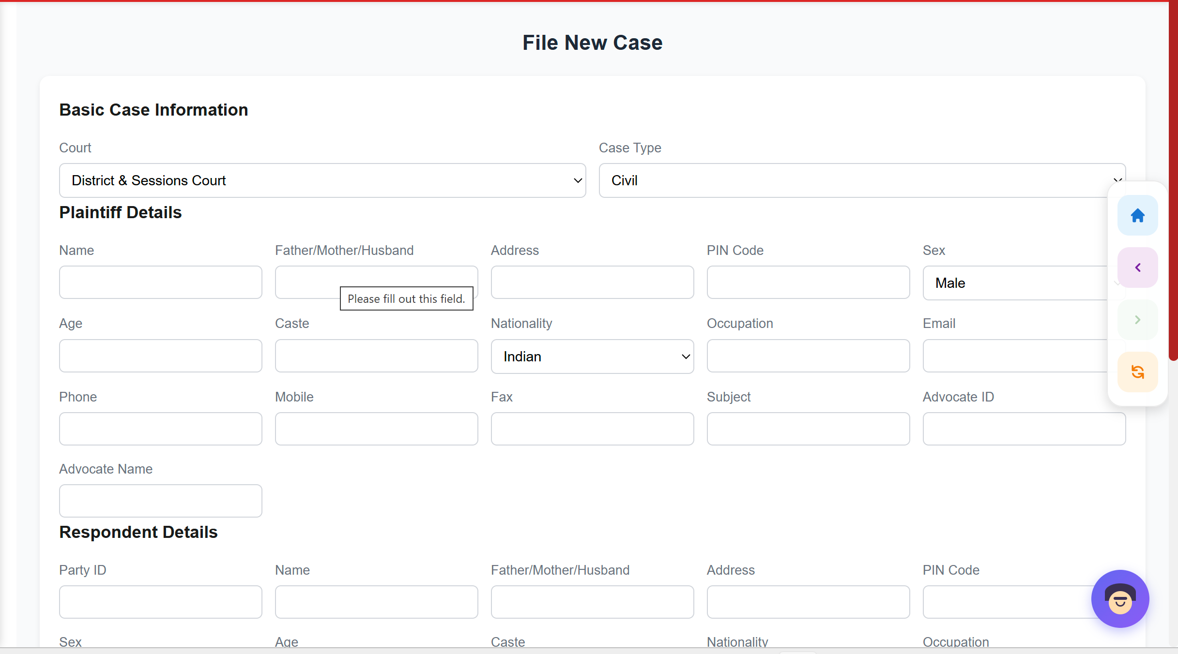
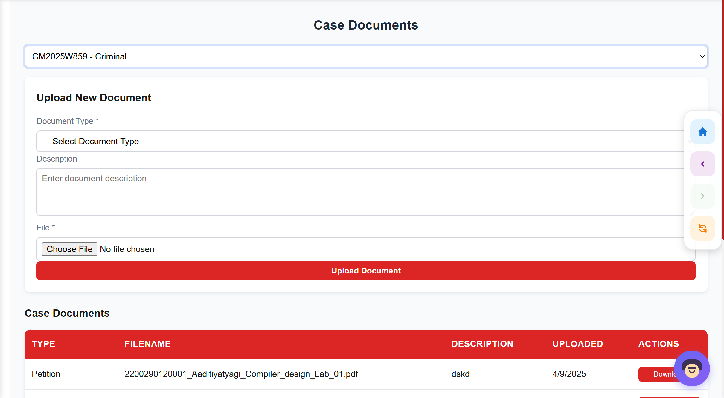

Slide 9
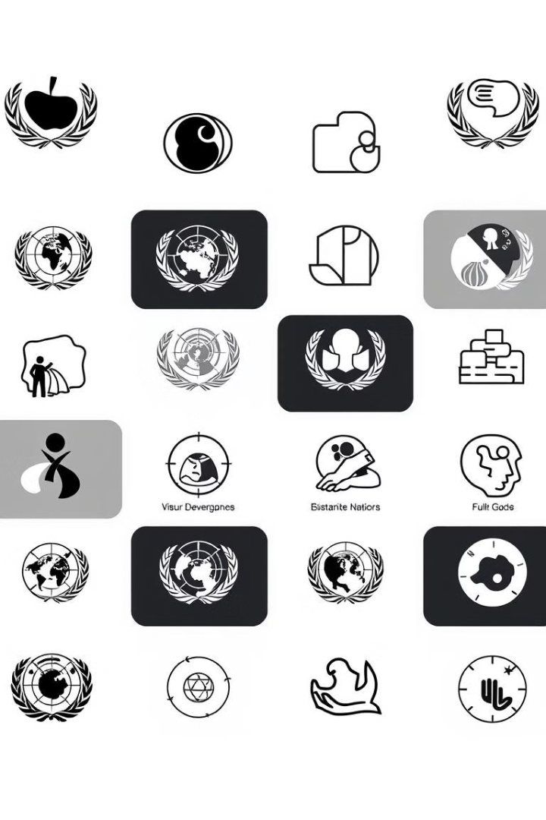
Alignment with UN Sustainable Development Goals (SDGs)
SDG 8: Decent Work and Economic Growth - Promotes efficient legal processes that support economic development.
SDG 9: Industry, Innovation, and Infrastructure - Encourages technological advancements in legal infrastructure and case management.
SDG 10: Reduced Inequalities - Aims to make legal services more accessible, reducing inequalities.
SDG 16: Peace, Justice, and Strong Institutions - Focuses on improving justice systems, ensuring strong legal institutions.

Slide 10

Technology Used
.
Backend: Node.js (Express framework)
Frontend: React.js
Database: MongoDB (NoSQL database)
Version Control: Git
Deployment Environment : Render

Slide 11
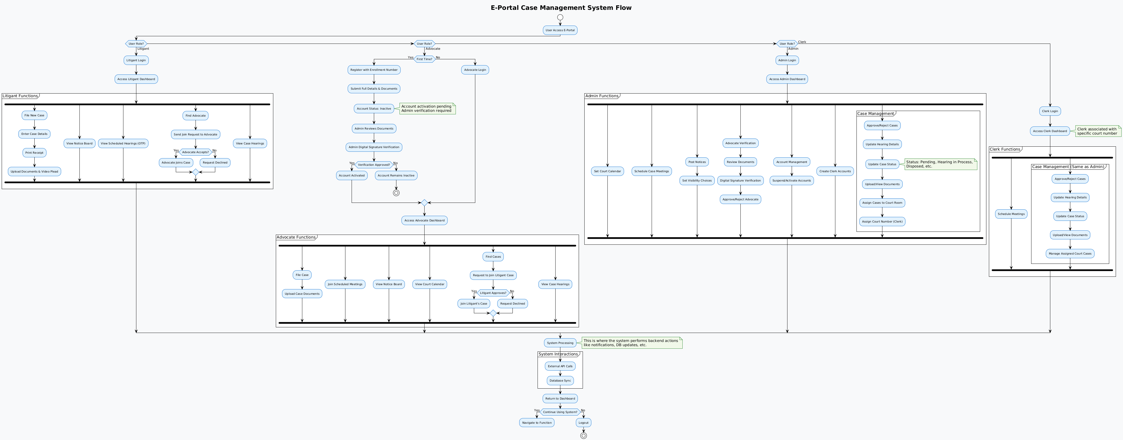
Flow Diagram

Slide 12


Enhanced Case Organization
Expected Outcomes
Enhanced Case Organization
Transparent Workflow
Real-Time Case Tracking
Reduced Caseload Pressure
Efficient Scheduling
Improved Document Access
Improved Productivity

Slide 13
References
A. Baig, “The role of technology in enhancing access to justice: Challenges and opportunities in the 21st century,” AL-AASAR Journal: Quarterly Research Journal, vol. 2, no. 1, pp. 774–779, 2025.
D. Pitaloka, “E-court: A digital disruption in law enforcement and its impact on judicial efficiency in Indonesia,” Ex Aequo Et Bono Journal of Law (EAEBJOL), vol. 2, no. 2, pp. 82–95, 2025. doi: 10.61511/eaebjol.v2i2.2025.1404.
D. Putranti, U. T. Putri, A. Prahara, and M. S. Quddus, “Proposing digital copyright infringements enforcement through Internet Court in Indonesia: Fostering the existing E-Court system,” E3S Web of Conferences, vol. 622, p. 03006, 2025. doi: 10.1051/e3sconf/202562203006.
CH. Prabhavati, A. Mounika, G. Devi Sri, K. Lahari, and K. V. Krishna, “Legal Connect: e-Portal for Facilitating Case Management Hearings of Various Types of Cases,” Int. J. Eng. Sci. Adv. Technol. (IJESAT), vol. 24, no. 5, pp. 322–327, May 2024.
A. Maralbaeva, E-justice and Cyber Security: Balancing between Openness of the Courts and Data Protection in Kyrgyzstan. United Nations Development Programme (UNDP), 2022. [Online]. Available: Link.
R. K. Ahmed, O. Ahmed, I. Pappel, A. Reitsakas, and D. Draheim, “The role of digital transformation in fostering transparency: An e-Court system case study,” in Lecture Notes in Computer Science. Cham, Switzerland: Springer Nature, Sep. 2022, doi: 10.1007/978-3-031-15342-6_17.
C.-L. Lee, “E-justice in Taiwan: The derivative inquiries from constitutional perspectives in the digital age,” Ritsumeikan Law Rev., no. 40, pp. 55–67, 2022.
B. G. S. Grepon, “Designing and implementing e-justice systems: An information systems approach to regional trial court case docket management in Northern Mindanao, Philippines,” Int. J. Multidiscip. Acad. Res., vol. 8, no. 1, 2020.

Slide 14
Thank
You

